Slide 1
CdS NATURAL AND CULTURAL RESOURCES ECONOMICS
Course of
Territorial Marketing
SECS-P/08 – C.F.U. 8
Dott. Mario Tani
mario.tani@gmail.com

Slide 2
In this lesson…
Introduction
Schedule and tests
Books, Materials and Work Groups
Some Advices
Territorial Marketing
What are we going to study?
Trouble for places
Internal and external influences
Place marketing

Slide 3
The course Schedule
The course will be held in this Room (Room 10)
Monday = 10:30 – 13:30
Tuesday = 11:30 – 13:30
The students will be able to meet with the professor after the lessons

Slide 4
The tests…
The tests will follow these rules:
Mandatory written test
15 yes/no questions (-1 to +1)
5 open questions (-1 up to +4)
Optional oral test
Students attending the course will have the opportunity:
To make a final test (+0 up to +3 bonus)
only for students attending 60% of the lessons or more
To do special homework (up to +5 to counter maluses)

Slide 5
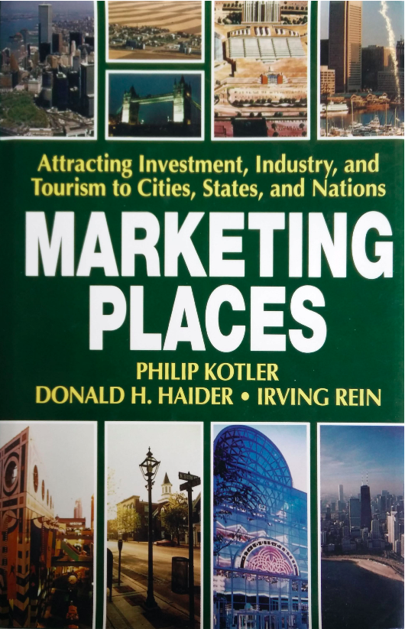
The course
You will have to use several materials:
The book Marketing Places
3 Articles distributed by the professor
Some chapters from a couple of other Books
These Slides!
Online tools (on your phone):
Google Forms
Kahoot!

Slide 6
Territorial Marketing
Let's start with a couple of questions…
…but before install a barcode scanner
https://goo.gl/rc4iKk
https://goo.gl/jSxMvy

Slide 7
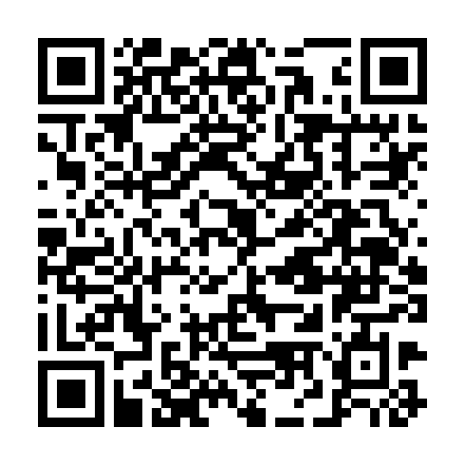
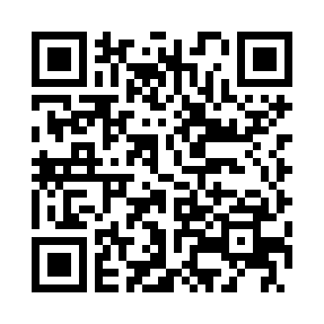
The Kahoot Online Platform
The kahoot! platform is a online quiz platform.
You can participate in the quizzes using the mobile app

Slide 8
The course
Some advices to get better results during the lessons:
Active listening
Participation
Common sense
How to prepare for the final tests?
Answer the provided questions
Discuss cases with colleagues

Slide 9
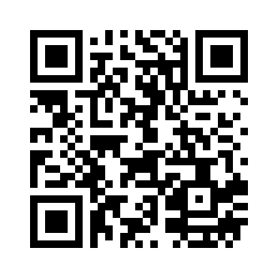
A first survey
https://goo.gl/forms/w9jxTd8AZw7SEtLt1

Slide 10
A first kahoot
Open Kahoot! and
«Enter PIN»

Slide 11
An exercise (part 1)
Let’s do a simple exercise:
Divide in 2 groups
Discuss 5 minutes
Write down the 5 most important words related to place marketing (no order)

Slide 12
Territorial Marketing
Local area
Life Quality
Investments
Governance
Jobs
Tourism
Factories
...

Slide 13
An exercise (part 2)
Discuss 5 minutes
Write down the 5 most important actors related to place marketing (no order)

Slide 14
Territorial Marketing
Citizen
Media
Investors
Institutions
Firms
Tourists
Other Local
Areas
...

Slide 15
Territorial Marketing
Two meaningful words to define
Stakeholder
System

Slide 16
Stakeholders
The term ‘stakeholder’ simply refers to all groups involved with a place.
Some Stakeholders are local businesses, politicians, investors, sports and cultural organisations, to ordinary residents… and many others
They are called “stake”-holders as they all have their own vested interests and opinions, often conflicting with each other.
The challenge is to get them all aligned with a shared place brand vision.

Slide 17
Systems
An entity made up of interconnected agents in a boundary separating them from an external environment.
Agents’ actions should be studied looking at their perceptions, values, resources, and taking into account the network structure.
Agents must be able to cooperate, coordinate, and negotiate with each other in order to create a set of interactions and find a balance
Complex Systems are synergic

Slide 18
Places as Complex Adaptive Systems
They are networks of relationships that are independent, interdependent, and layered.
Complexity refers to a large number of autonomous agents that interact with one another through the presence of feedback mechanisms.
The behaviour of a CAS as a whole can be different from the sum of the behaviours of its individual agents
CAS main properties: Complexity – Emergence – Self-Organization – Co-evolution – Adaptation – Path dependence – Multi-level Structure

Slide 19
Places as Comples Adaptive Systems
Suprasystems
Level
Governance
Level
Key Agents and
People Level

Slide 20
Places in Trouble
According to S&P in the 80s:
Almost 60% of the USA states and more than 5000 towns are in financial troubles
The crisis is a global one...
Rio de Janeiro declared Bankruptcy in 1988
Naples' City Council defines a recovery plan of 1,4 billions (The TASI on the 1st house in all Italy).
Naples' City has got 220 mlns from the State to avoid bankrupt and 297 mlns from Cassa depositi e prestiti to pay back suppliers. So, the city council has reduced the deficit from 783 to 267 mlns
What are the consequences of these “troubles”?

Slide 21
Places in Trouble
Consequences of “trouble”?
Fiscal un-health
Trade inbalances
Rising debt
High inflation
Unemployment
Falling Income
Loss of population

Slide 22
Classes of places
Dying or Chronically Depressed
Acutely Depressed
Boom and Bust
Healthy Transformations
Favorites Few

Slide 23
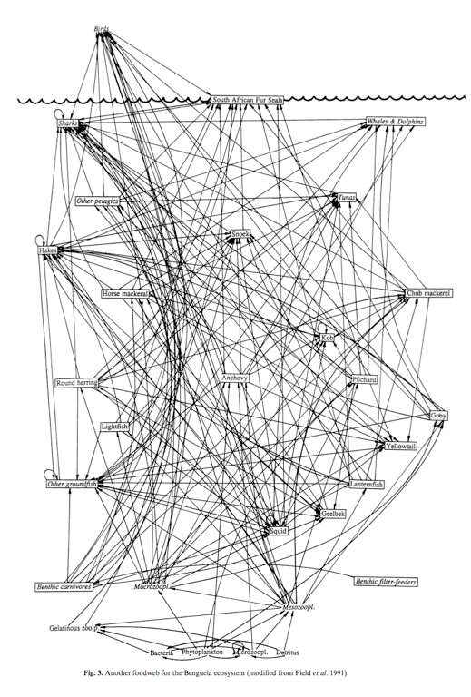
The Causes of Trouble?
What are the causes of troubles?
Each place is potentially open to two different influences:
Internal growth and decline cycles
External shocks and forces beyond its control

Slide 24
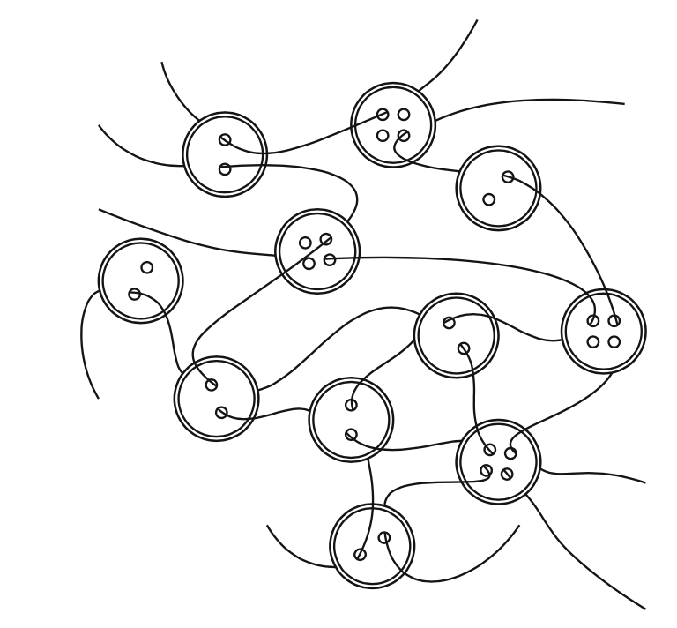
Jacob/Kauffman Model of Place
Jacobs (1961) a place is an “organized complexity:
‘in which a half-dozen or even several dozen quantities are all varying simultaneously and insubtly interconnected ways’ (Jacobs 1961, p. 433).
Place as Kauffman button model… what happens pulling a string or a button?

Slide 25
Why places end up in trouble…
Where systems are complex—where interactions and parts are changing all the time—how then is it possible to devise effective plans? Where systems are too complex to be reduced to an analytical model and too complex to be modeled in termsof statistical averages, how can results of purposive activities be foreseen?

Slide 26
City Growth Dynamics
Place is attractive
New industry start-ups
Job opportunities are strong
Life quality is attractive
Inward migration of visitors and new residents
Inward migration of new business and investments
Real Estate Costs rises
Infrastructure is strained
Social Needs Rise
Government Raises Taxes

Slide 27
The case of Orlando…
Orlando was a peaceful city before Disneyworld
In the 90s was one of the fastest growing city in the USA
What was happening? It was all good/bad?
Discuss in 2 groups.
Identify three main advantages and three main issues
P.s. You can use your smartphones…

Slide 28
The case of Orlando…
Main Advantages:
New jobs
New sources of Taxes
Foreign Investments
Main issues:
Natural resources get depleted
Malls growing everywhere
Traffic Jams

Slide 29
City Decay Dynamics
Place becomes unattractive
Major Company od industri is hurt or exits
Economic recession hurts business
Unemployment climbs
Infrastructure breaks down
City budget deficit increases
Outward migration of people
Outward migration of business
Tourism, Convention Business fall off
Banks tighten credit,
Bankruptcies increase,
Crime increase
Social needs rise,
City image deteriorates
Government Raises Taxes

Slide 30
The case of Philadelphia…
Philadelphia was at its pinnacle at 1976 (200 years from signing the Declaration of Independence)
During the 80s a building book further rivitalized the city but...
The citizens started moving in the suburbs
Less taxes lead to less services
More Crime, homelessness, drugs, and AIDS
The city started issuing junk bonds
By 1990s it has a $ 229 mln deficit and faced bankruptcy

Slide 31
External forces
Technological Change
It is a continuous process of “cretive destruction”
Cars created crisis for horses booming gasoline
Nylon created crisis for cotton growers
Today most peoples are knowledge workers
Globalization
Communities become sellers of goods and services to businesses
Growth of self-employed
Role of Governance
Protectionists – Government activists – free traders

Slide 32
Territorial Marketing
How is globalization changing the rules of the game?
Think of its effect on:
Scope, Driving Force, Main Resources, Kind of Jobs, Work Organization, Markets, Worker Competences and Tasks, Main Technology, Information Flows, Opportunities

Slide 33
Globalization
Characteristics | Old | New
Scope | Domestic | Global
Driving Force | Mass Production | Technology, innovation
Resource | Capital | Knowledge, information
Jobs | Stable, large firms | Dynamic, smaller firms
Organization | Centralized/hierarchical | Matrix, fluid, decentralized
Market | Stable | Fluid
Workers | Uneducated, unskilled | Educated, skilled, adaptive
Tasks | Simple, physical | Complex, intellectual, participatory
Technology | Mechanical | Electronic, biological
Emphasys | Predictability | Innovation, creativity
Information Flows | Top-down | Bottom-up, interactive
Opportunities | Limited, fixed | Fluid, rotational, mobile
Business / Government | Minimal intervention | Cooperations, partnership
Symbol | Smokestack | Computer

Slide 34
How places address troubles?
A few do nothing
Most of them scramble for resources
Lobbying state
Issuing bonds
Raising taxes
Aggressive programs to attract industry and tourists
Tax abatements and Business incentives
Financing expensive attractions
Preventing current businesses from exiting

Slide 35
How places address troubles?
Are these solutions “place marketing” practices?

Slide 36
How places address troubles?
No!
They are only promotion programs!

Slide 37
Strategic Place Marketing
Marketplaces evolve faster than communities changes
They have to act before changes does happen
Place marketing activities:
Design the right mix of community features and services
Setting attractive incentives for current and potential buyers of local area goods and services
Delivering places goods and services in an effective and accessible way
Promoting the place's values and image to make potential users aware of its distintive advantage

Slide 38
Levels of Place Marketing
Target Markets
Exporters
Tourists and
Conventioners
Marketing Factors
Investors
Infrastructure
Planning Group
Citizens
Attractions
Diagnosis, Vision, Action
People
Business
Government
Manuf.
New
Residents
Image and
quality of life
Corporate
Headquarters

Slide 39
The first exercise (due date: 03/28/2018)
Describe Potenza (or Matera) with a place marketing perspective.
Define its Key Agents, People, and the actors in the various local system levels.
Identify their relationship sets, their goals and agent’s actions
Draw a multilevel system diagram
Define it’s Place Class
Output: 1 picture + up to 1000 words (2 pages)
Results: 1 Error

